Slide 1

Implementation Plan for Streamlined Fisheries Science Advice Templates (FSAR/FSRR)
Discussion with Pacific Salmon Working Group
March 27, 2024
Internal Engagement Lead
Fish Population Science Branch
NCR
Notes:
Julie's notes – missing in here are the Terms of Reference; R code; possibly others.

Slide 2

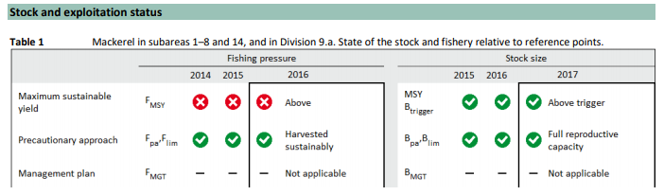


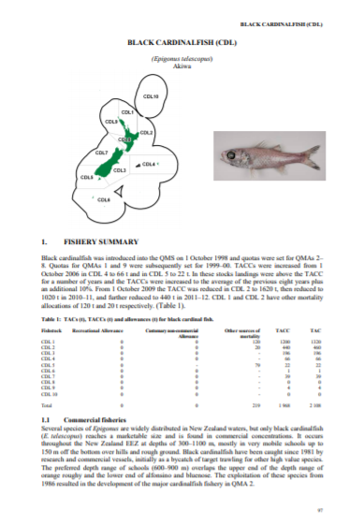
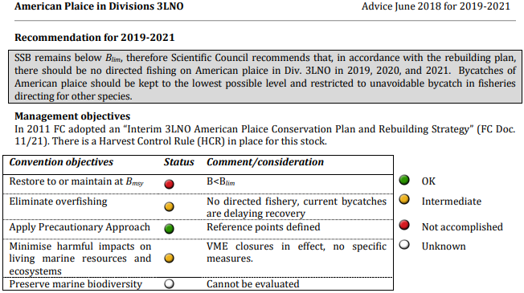


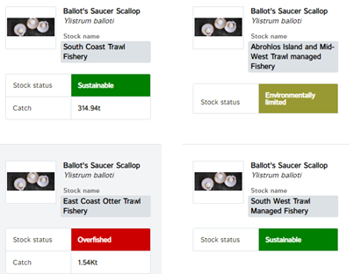

The FSAR initiative stems, in part, from an aim to bring science advice in Canada into closer alignment with international practices.

Slide 3
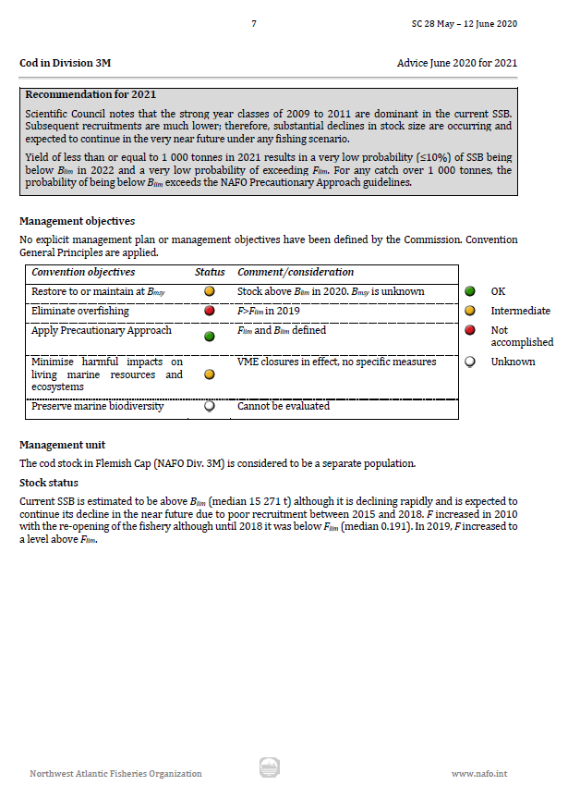
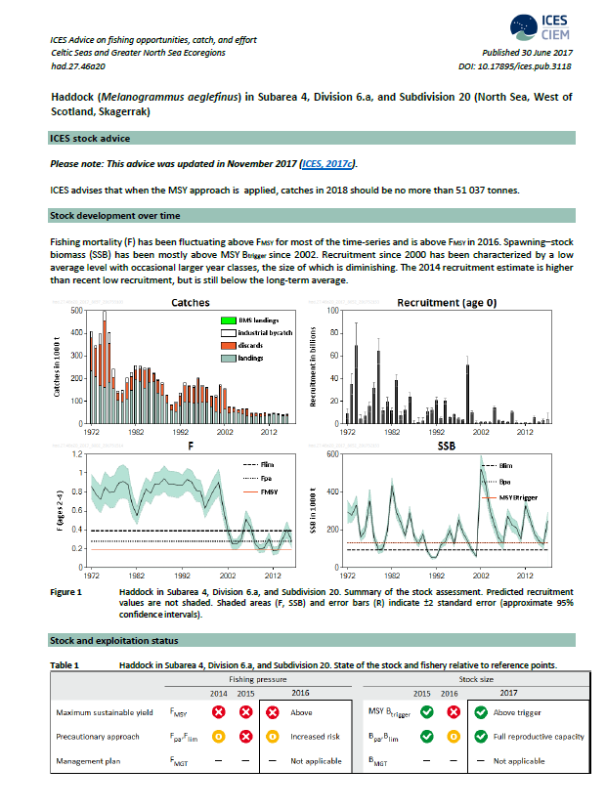
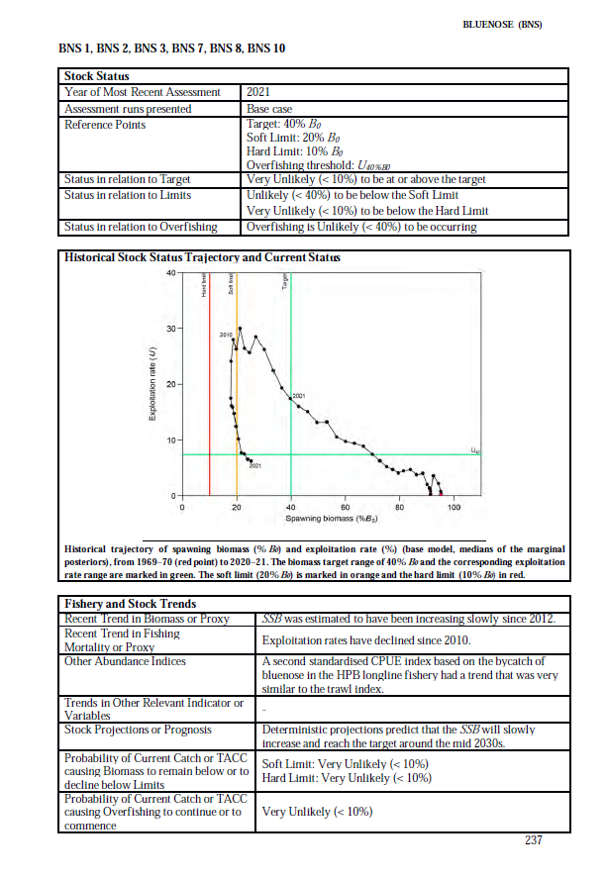

Brief, highly structured summaries, single stocks, virtually no background or technical information, few to no paragraph-style narrative sections; separate from complete assessment documentation

Slide 4







Achieved by… One toolkit
Goals of the FSAR Initiative
Standardized; common look and feel
Consistent with international practices
Streamlined; focus on advice used for decision-making
More timely advice
Aligned with Departmental tools and Fisheries Act
Provide foundation for EAFM, Open Data initiatives
Full Assessments and MSEs
FSARs
That will meet the needs of both…
Interim Updates
FSRRs

Slide 5
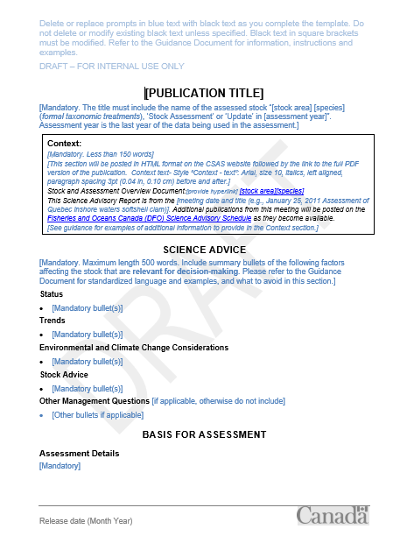
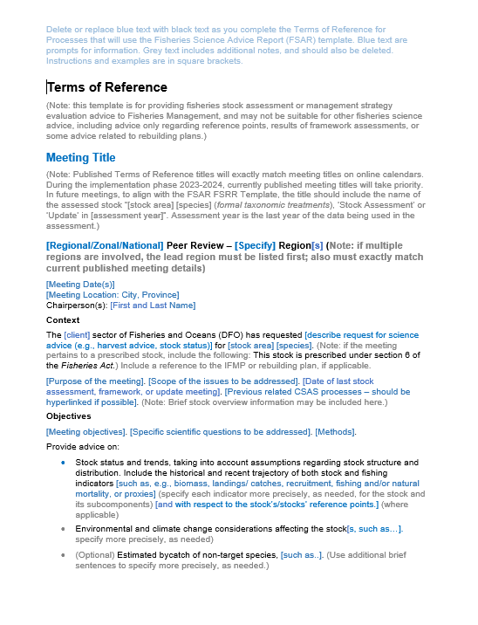
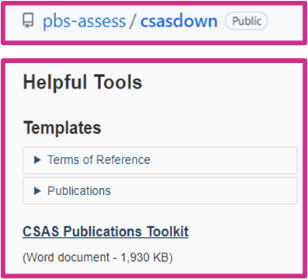
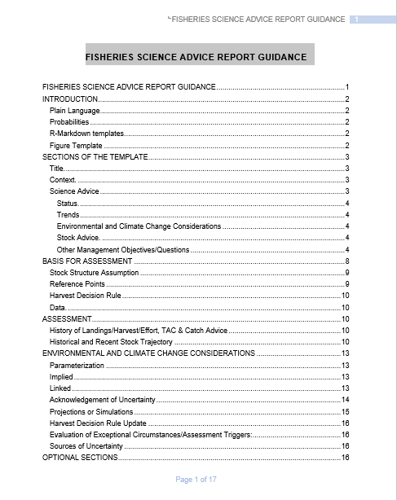
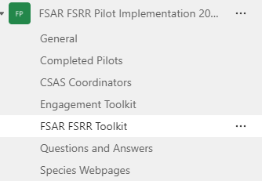
What’s in the Toolkit?
(3) Supports: a
template for
CSAS Terms of
Reference, and R
code for mandatory CSAS report figures, and eventually an updated CSAS Publication toolkit
(1) A CSAS report template where the advice goes
(2) Guidance on how to fill out the report template
What isn’t Changing?
Research Documents will continue to house the full assessment documentation, including background and technical methodology. Research Document templates are not changing, and there is no minimum/maximum page limit.
The “old” SAR/SRR templates are also still available for other types of advice.
Link

Slide 6
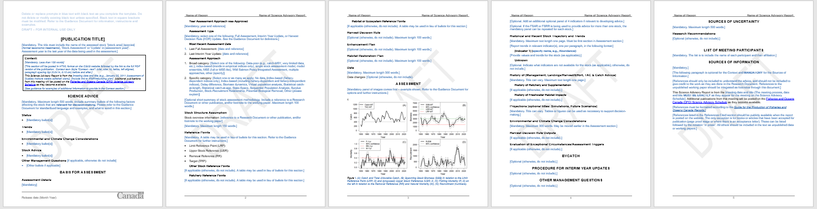
A closer look at the template
Many more headings than original “SAR”: resulting report appears more ‘formatted’
Note: many but not all headings are mandatory – but ‘not available’, ‘unknown’, etc. are possible content
Word limits & recommendations on plain language: to help foster more concise, readable advice
Mandatory stock status figures: replacing mandatory maps
Summary information in one place: only in bullets, not in bullets plus conclusions

Slide 7
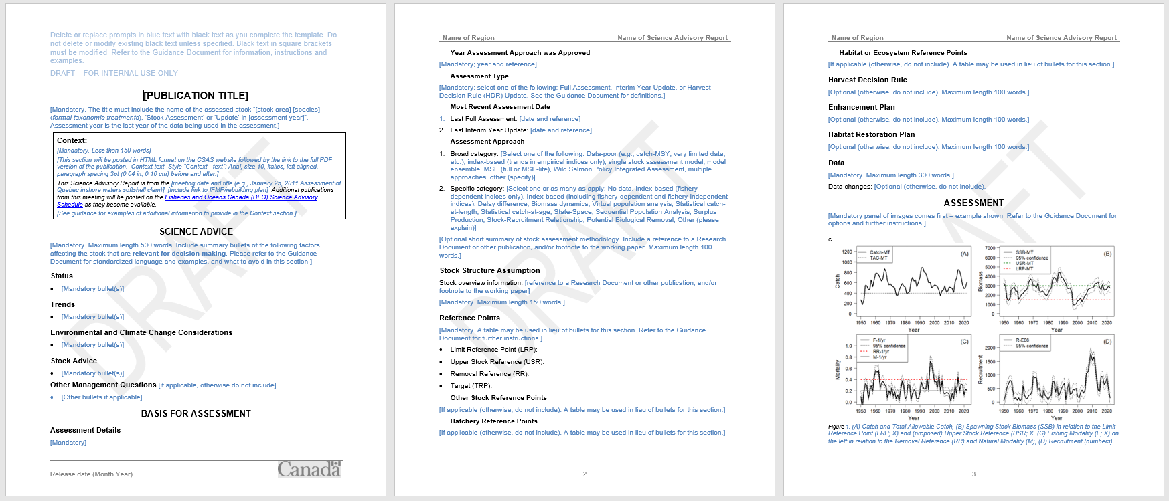
A closer look at the template
Relevant indicator(s) for…
“Summary” is now called “Science Advice” and are structured into sub-headings
Removals over time
Stock status over time
If an indicator doesn’t exist, keep panel in but leave blank
Mortality over time
Recruitment over time
Include reference points where they exist
“Basis for Assessment” provides high-level overview of advice context/ inputs that may need to tracked or be cited in decision-making

Slide 8
A closer look at the template
“Assessment” section: Stock first, then management
Dedicated section for forward looking advice
No separate Conclusions; Research Recs framed in light of stock assessment
Environmental and Climate Change Considerations is a floating section

Slide 9
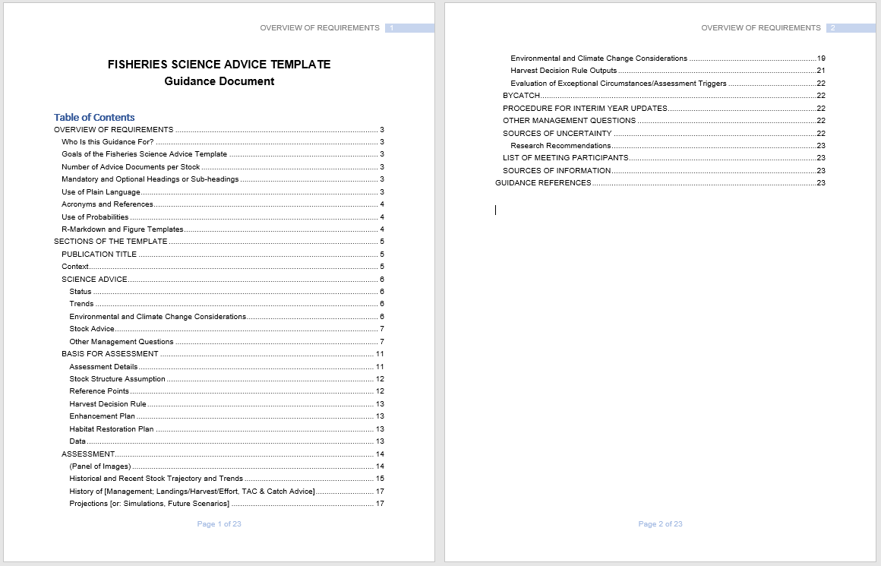
A Closer look at the FSAR Guidance Document
One FSAR per stock; use best judgement for spatially complex situations
Some guidance on “plain language”, and other common editorial issues such as acronyms, references and probabilities
Section-by-section breakdown of guidance, including example text

Slide 10
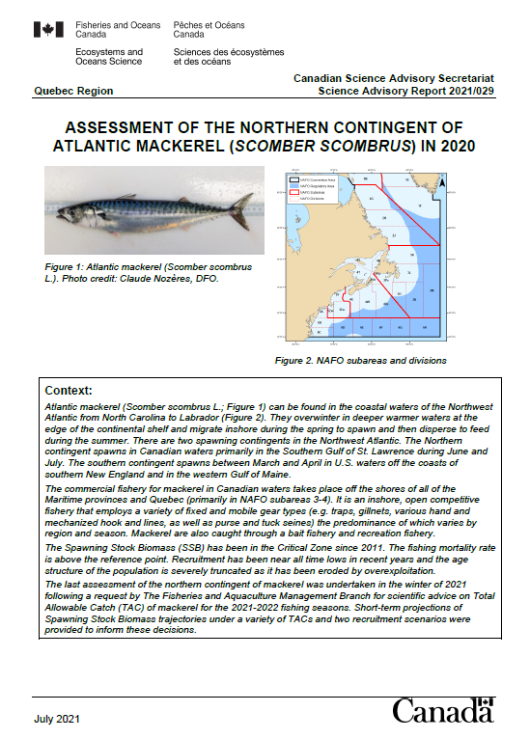
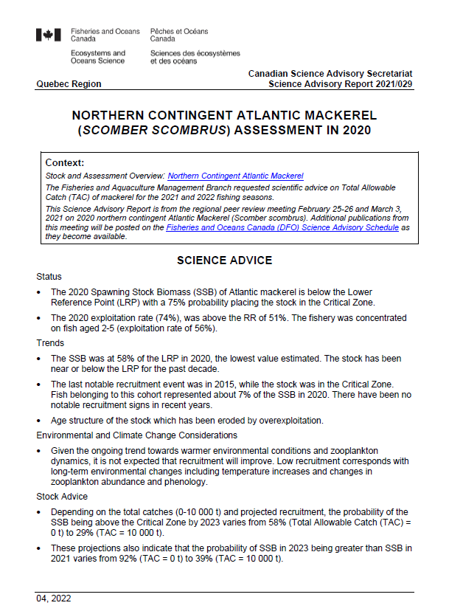
Biggest Changes for FSAR versus “old” templates
SAR and SRR as distinctly formatted “short papers” that served multiple purposes
SAR and SRR for fisheries science advice as “formatted summary sheet”
Limited background, methods or technical information; no narrative-style Intro or Conclusions
Loss of institutional redundancy = increased reliance on Research Documents to cover full basis for the advice
Ongoing concerns include:
Where to place Indigenous Knowledge
Fitting template to spatially complex or data-poor stocks
Paradigms that aren’t “single species-single best assessment model” e.g., Management Strategy Evaluations

Slide 11
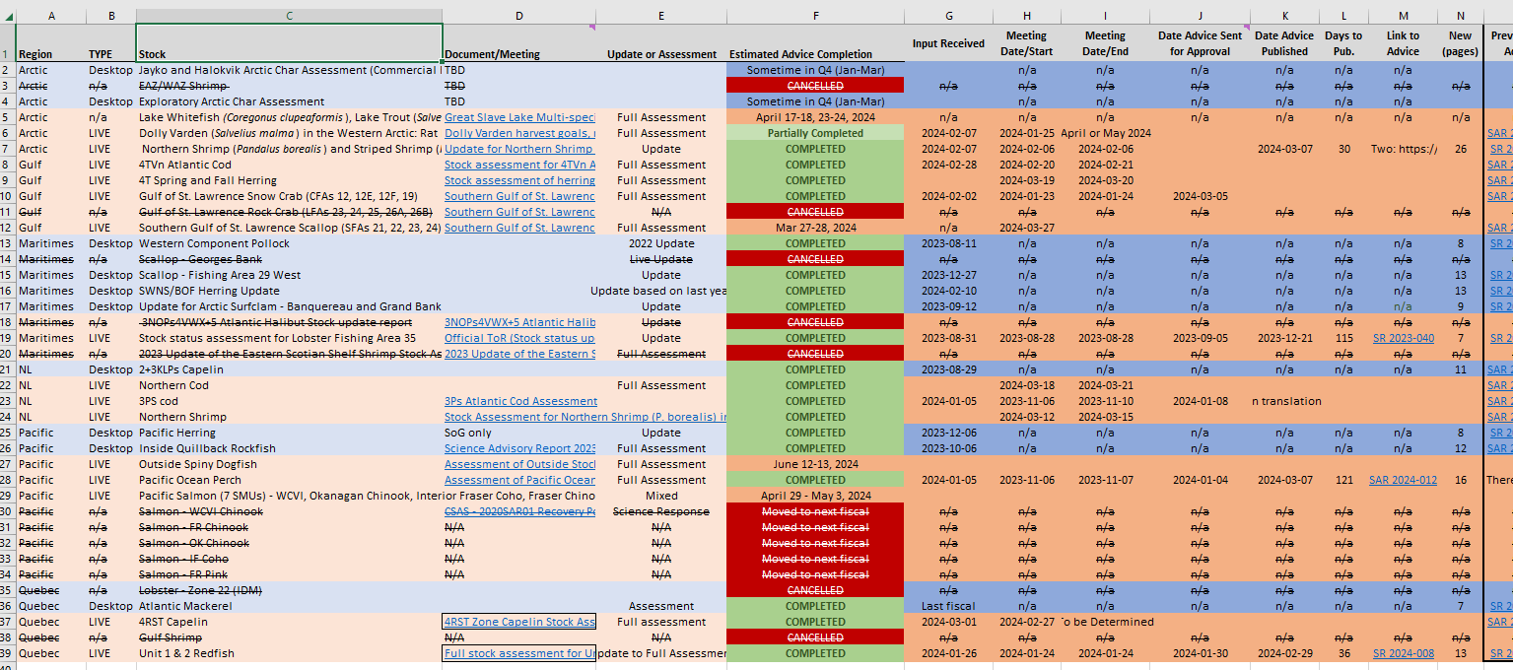
Completed and Published FSAR/FSRRs
Pilot Tracker

